Slide 1
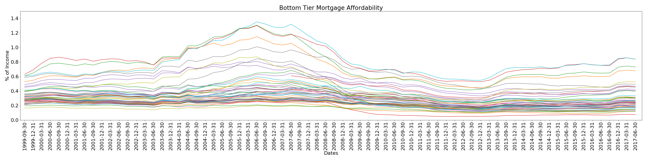
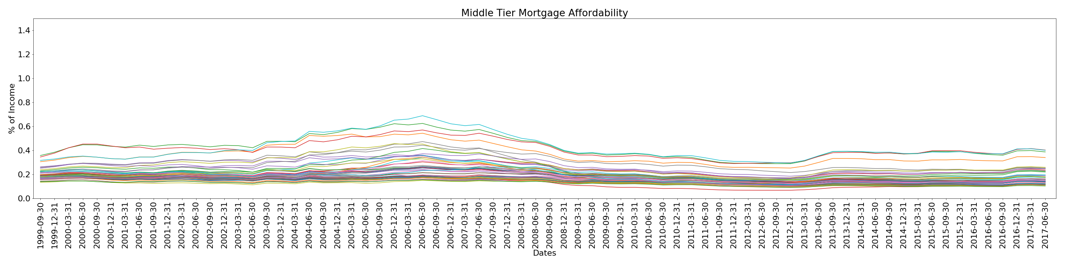
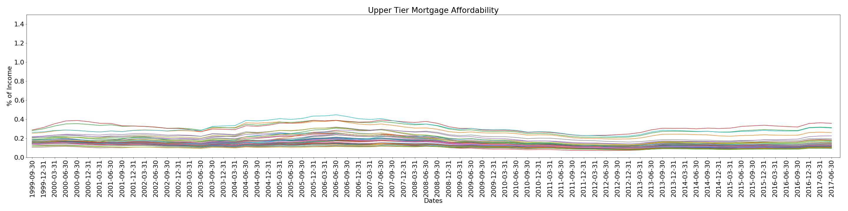
A
F
F
O
R
D
A
B
I
L
I
T
Y

Slide 2
Bottom Tier Mortgage Affordability

Slide 3
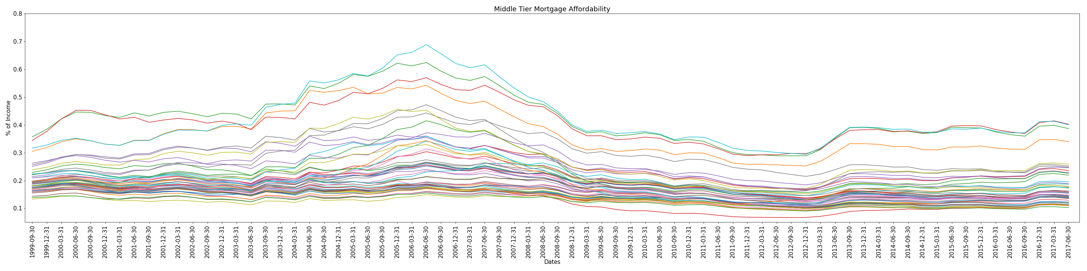
Middle Tier Mortgage Affordability

Slide 4
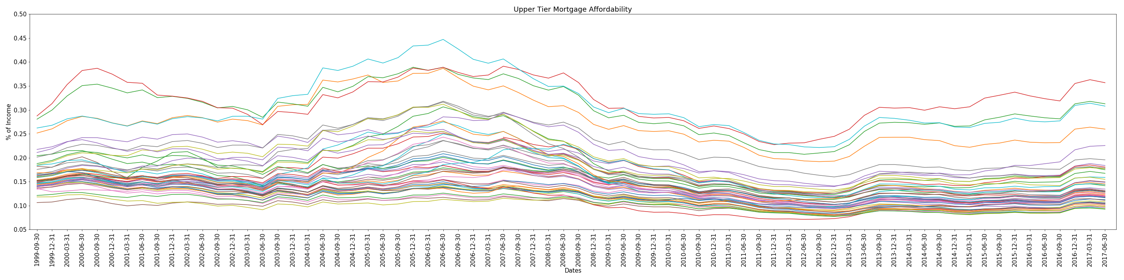
Upper Tier Mortgage Affordability

Slide 5
Freddie Mac and Fannie Mae Demographics
2008 |  | 2017
Income | $393,526 | Income | $110,800
Males | 2,887,904 | Males | 2,326,235
Females | 1,234,386 | Females | 1,110,531
Avg. Age | 46.0 | Average Age | 46.5
1st Time Age | 36.0 | 1st Time Age | 36.4
1st Time Income | $120,095 | 1st Time Income | $87,058
Total Mortgages | 4,683,120 | Total Mortgages | 3,705,045

Slide 6
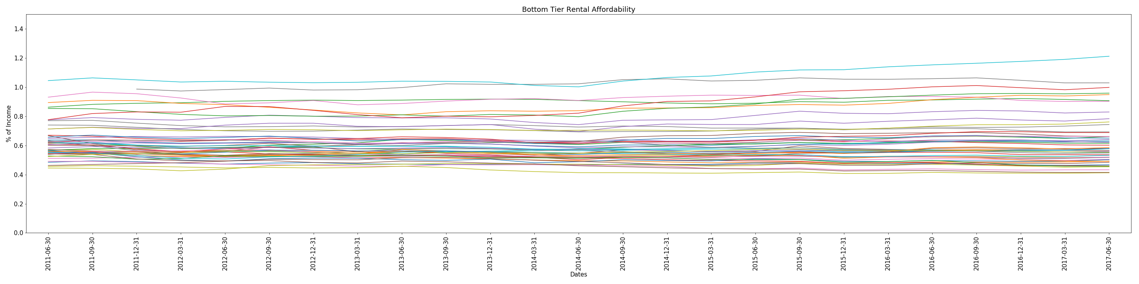
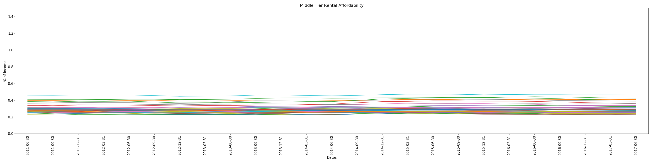
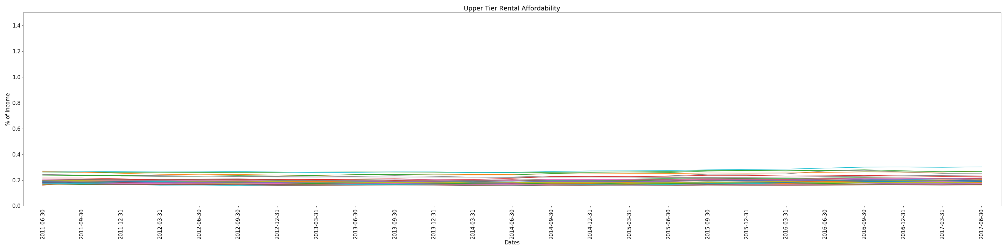
A
F
F
O
R
D
A
B
I
L
I
T
Y

Slide 7
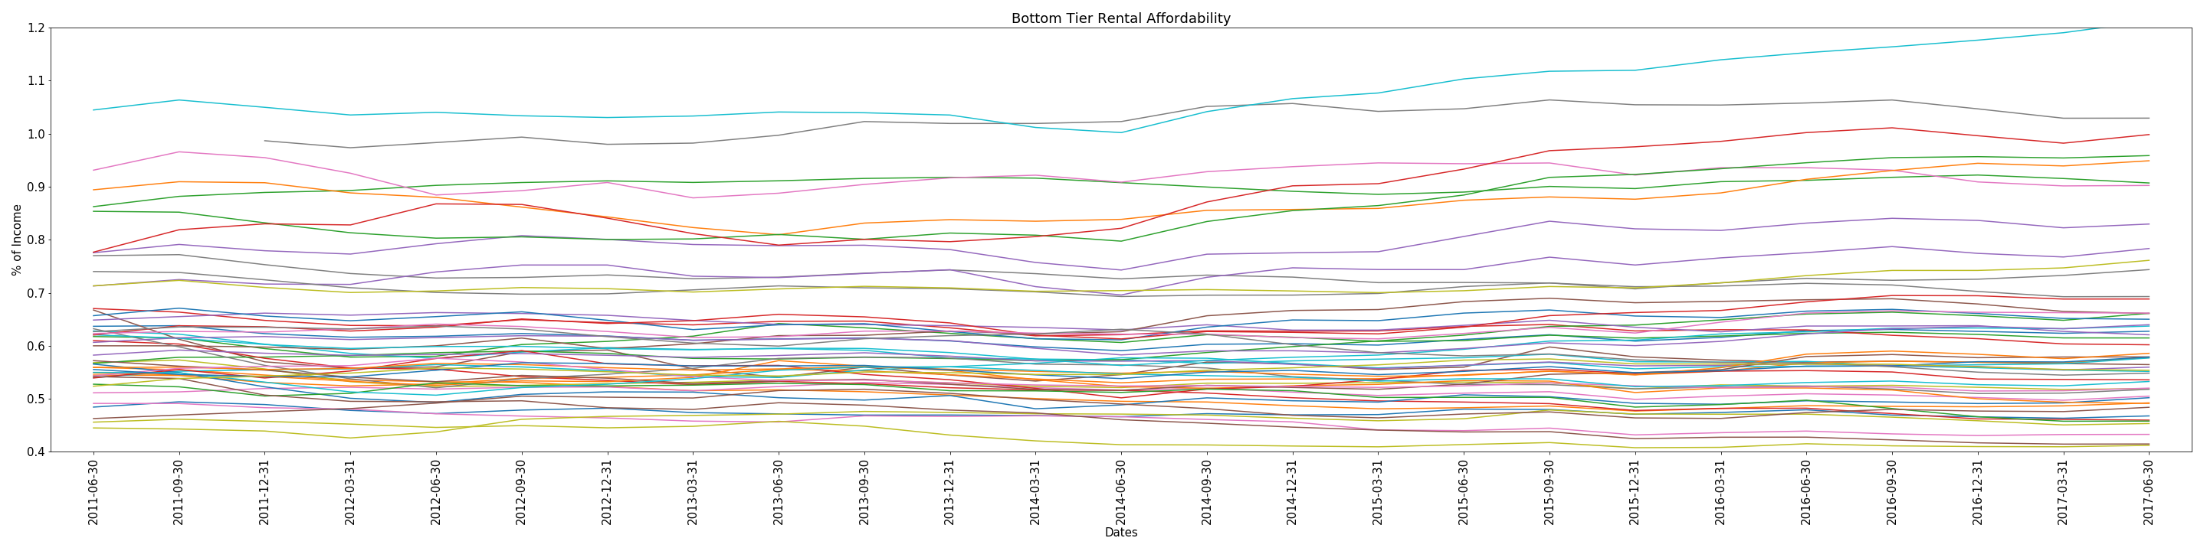
Bottom Tier Rental Affordability

Slide 8
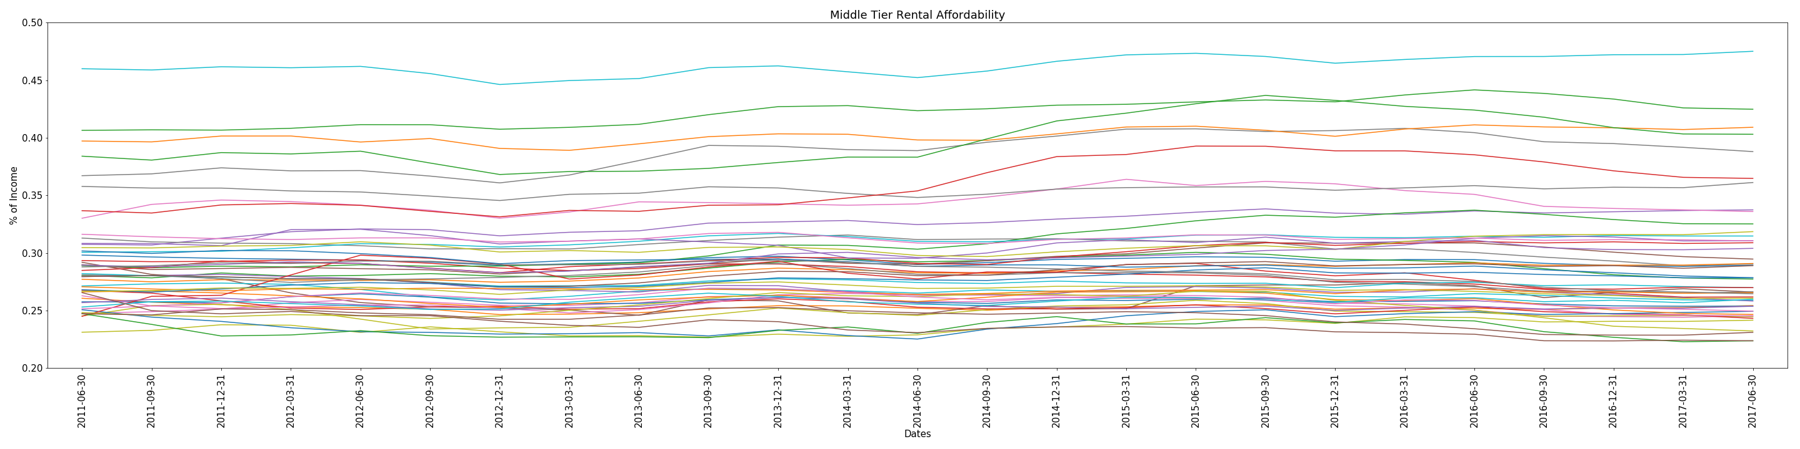
Middle Tier Rental Affordability

Slide 9
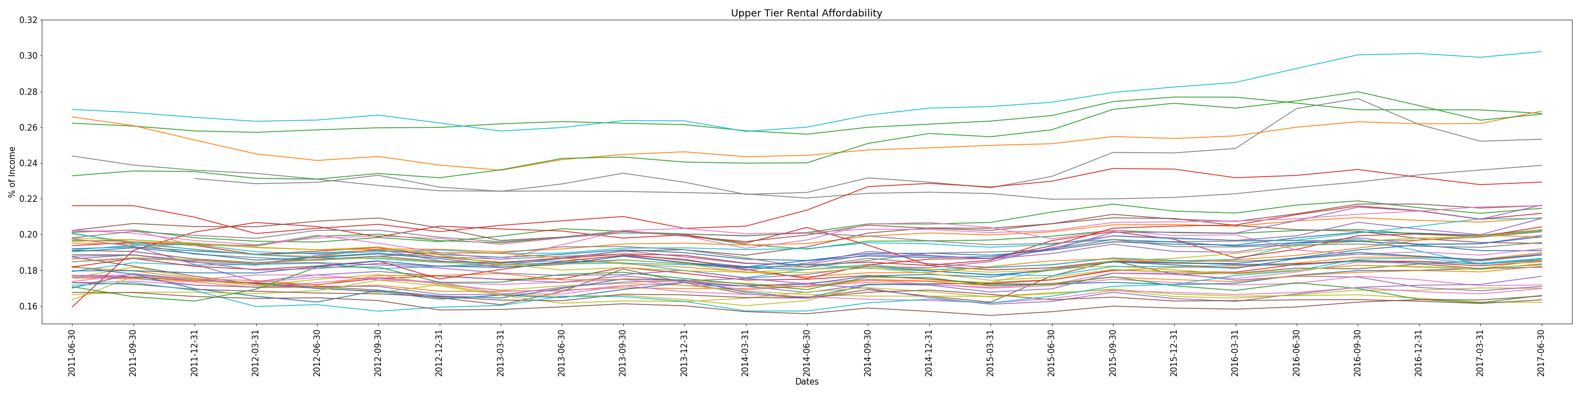
Upper Tier Rental Affordability

